Slide 1
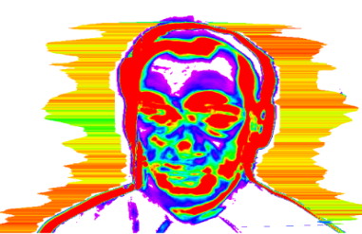
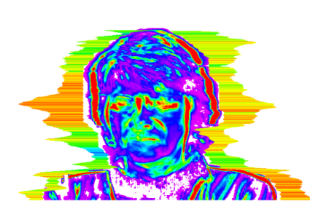
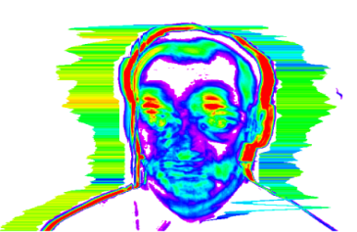
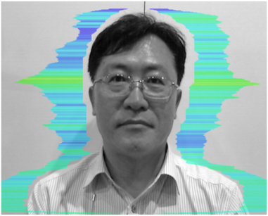
Video Polygraph Application
[Statement Analysis]
RESEARCH OF VIDEO POLYGRAPH FOR LIE DETECTION WITH STATEMENT ANALYSIS BY VIBRAIMAGE TECHNOLOGY
2018 June
VIBRASYSTEM

Slide 2
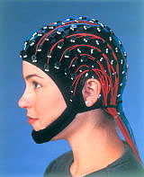
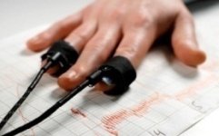
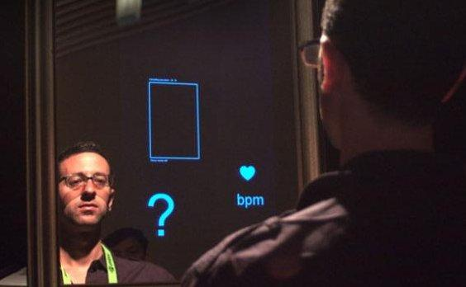
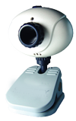
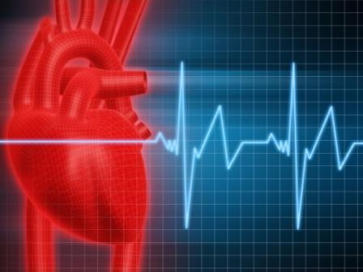
Why Video Polygraph system?
Contactless and Nonrestraint investigation
Vibra Image technology basis by using video image
Analyze and indicate the real time PDD(Psycho-physiological Detection of
Deception) level
Very short period for final judgment (DI, NDI, INC)
- Analysis of a various Question and Answer
VibraImage Technology basis
Civil
Liberty
Scientific
Investiga-
tion
Overcome limitation & Improvement
Revolutionary Polygraph
(Video Polygraph)
Bio-Signal
Contactless, Nonrestraint

Slide 3
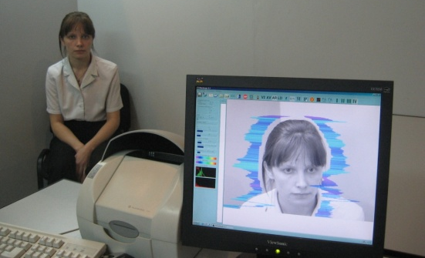
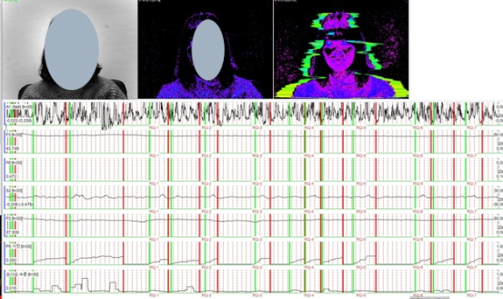
Overview of Video Polygraph
Video Polygraph Product
1. Video Polygraph- Classic
100% compatible process with traditionally contacting
polygraph (Accuracy rate : Up to 95%)
: No need to change the currently contacting polygraph
process with Beckstar, Utah…
Very quick judgment based on Vibraimage’s PDD raw data
To protect civil liberty and improve for scientific investigation
User friendly, Contactless, Nonrestraint and Economic system
To provide and analyze criminal’s psychology state (emotion)
Very high accuracy with much less ratio of INC
2. Video Polygraph- Interview
To indicate Probability of Lie during interview and statement
To deepen Pre-Test process before LD investigation
To select the key words to be questioned in LD process
To make investigation more efficient at the very early stage of
investigation by interview and statement to criminal
First Video Polygraph system for indicating Lie probability on
interview and statement
- User friendly, Contactless and Nonrestraint
Notes:
공격성 (P7) 스트레스 (P6) 긴장/불안 (F5X) 의심 (P19) 밸런스 (P16) 매력 (P17) 에너지 (P8) 자신감 (P18) 억제 (F6) 신경과민증 (F9)

Slide 4
Products
1. Video Polygraph program
1) Video Polygraph-Classic version
2) Video Polygraph-Interview version
* Program is sold individually by VIBRASYSTEM’s Licensing
2. Protections should be simultaneously taken for installation
and operation
1) USB Dongle : Elsys’s USB dongle
2) Software Licensing to Video Polygraph’s hardware system
3. Each operation manual
4. Hardware
- Video Polygraph Analyzer (Based on PC system)
- Camera
- Microphone
- Cables and others
5. Colored or White screen for background (Option)
Notes:
공격성 (P7) 스트레스 (P6) 긴장/불안 (F5X) 의심 (P19) 밸런스 (P16) 매력 (P17) 에너지 (P8) 자신감 (P18) 억제 (F6) 신경과민증 (F9)

Slide 5
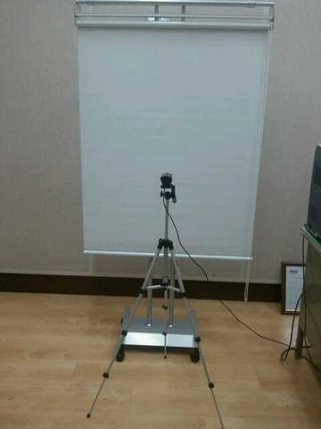
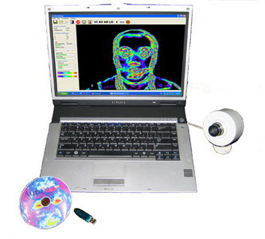
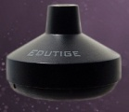
System Components
microphone
- Camera
(White screen)
- Others
Video Polygraph Analyzer
[Desktop PC recommended or NT PC]
+ Program installed
Notes:
공격성 (P7) 스트레스 (P6) 긴장/불안 (F5X) 의심 (P19) 밸런스 (P16) 매력 (P17) 에너지 (P8) 자신감 (P18) 억제 (F6) 신경과민증 (F9)

Slide 6
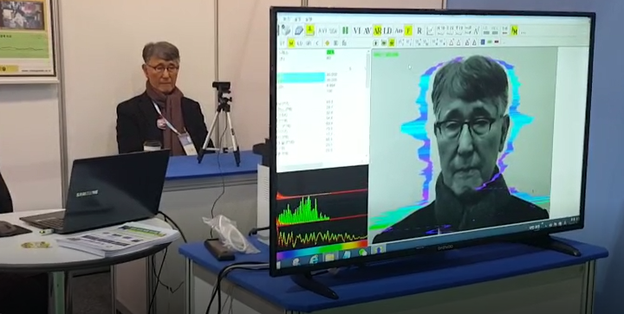
Interview mode
Testee
Camera
VibraImage
VIBRASYSTEM
Notes:
공격성 (P7) 스트레스 (P6) 긴장/불안 (F5X) 의심 (P19) 밸런스 (P16) 매력 (P17) 에너지 (P8) 자신감 (P18) 억제 (F6) 신경과민증 (F9)

Slide 7
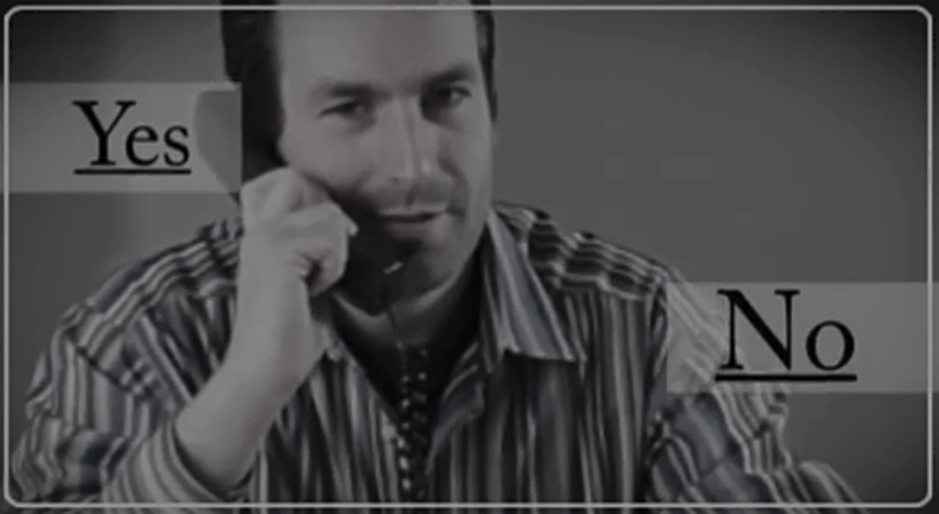
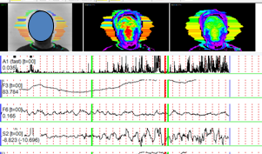
VIDEO POLYGRAPH-
Interview
World First VIDEO POLYGRAPH system
For Interview and Statement

Slide 8
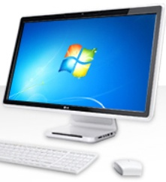
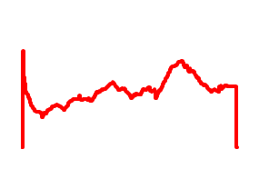
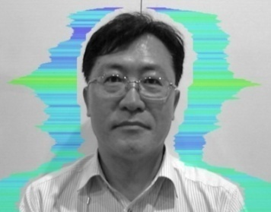
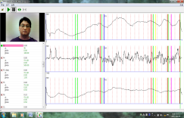
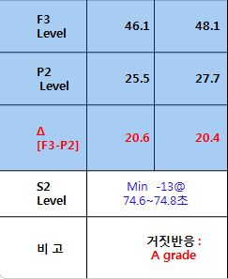
Product Overview
VIDEO PLOYGRAPH – Interview & Testimony
camera
VIDEO POLYGRAPH
program
Lie Probability Index (%)
criminal
Capture video
image
70
analysis
VIDEO POLYGRAPH solution was developed and collaborated by Korean Government Funding from 2013 – 2015 year
(Korean Police Agency, Korea Univ. SangMyung Univ, VIBRASYSTEM)

Slide 9
New Generating Question Process
5 stage : Optimized Question Process
1st State Tracking
(ST)
2nd Adaptive Preparation
(AP)
Measure Psycho-Physiological state
before Video Polygraph testing (1 Min)
General question like family, career, school, testing room etc.
[Individualized Reference Data]
3rd Issue Recollection
(IR)
4th Concrete Clarification
(CC)
Relevant question for the related case
(Overall issue)
Relevant question for the related case
(Detailed issue)
5th Arrange Tracking
(AT)
Measure Psycho-Physiological state
after Video Polygraph testing (1 Min)

Slide 10
Question sample
Stage | Question type | Question and Answer
1 | ST | Please look at the front side without any movement ! And then, test Psycho-physiological state during 1 minute
2 | AP(Q) | Please explain the detailed history from elementary school to university that you graduated in the past.
3 | AP(A) | ---------
4 | IR(Q) | Please explain that situation related to the accident !
5 | IR(A) | --------.
6 | CC(Q) | Did you hit his face and head by your hand or what..?
7 | CC(A) | -------------
8 | AT | Please look at the front side without any movement ! And then, test Psycho-physiological state during 1 minute

Slide 11
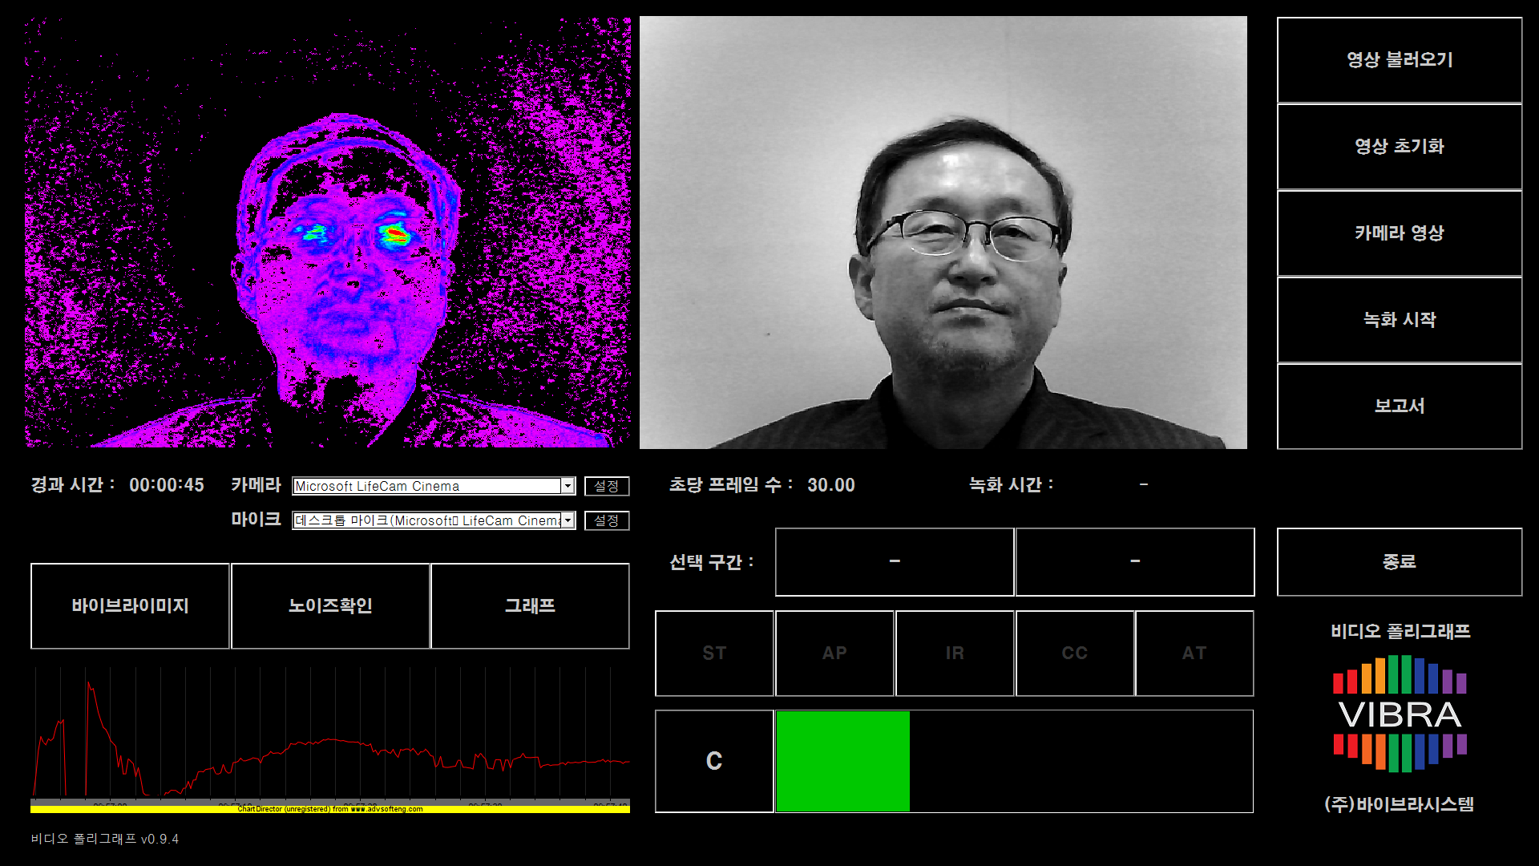
GUI Design

Slide 12
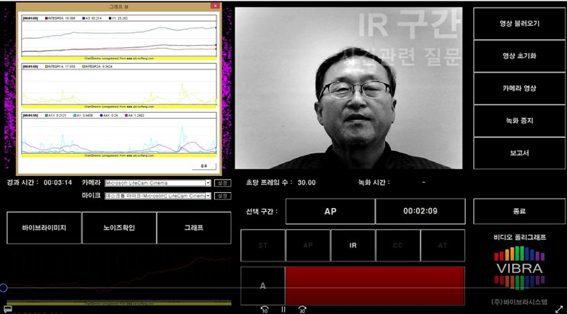
GUI Design

Slide 13
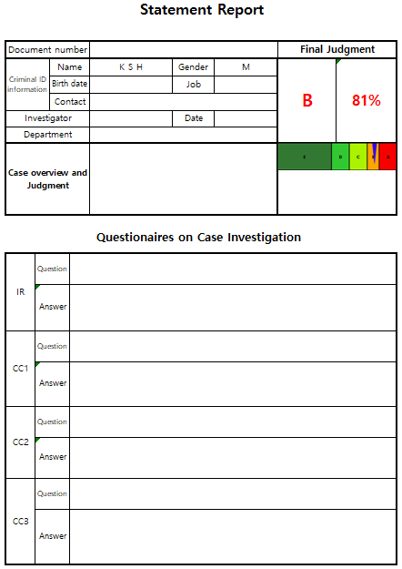
Report sample
Overal Report Sample
Analysis Result :
Judged by DI over “B” grade

Slide 14
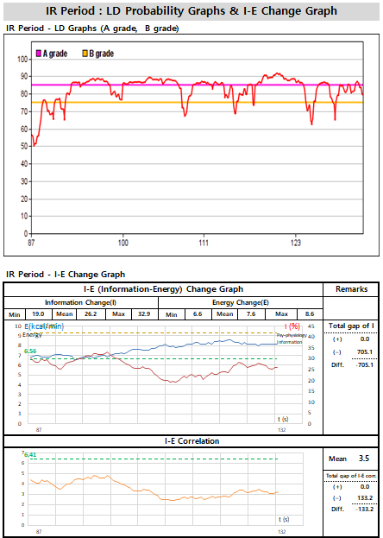
Report sample
1) LD Level graph
2) I-E (Information-Energy) graph

Slide 15
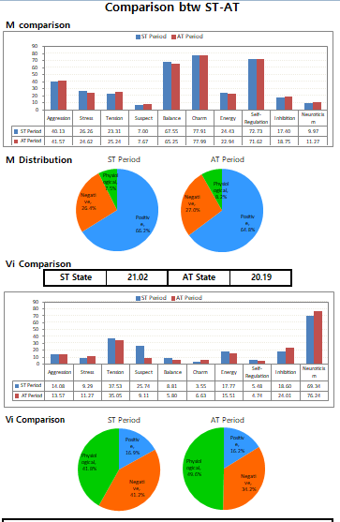
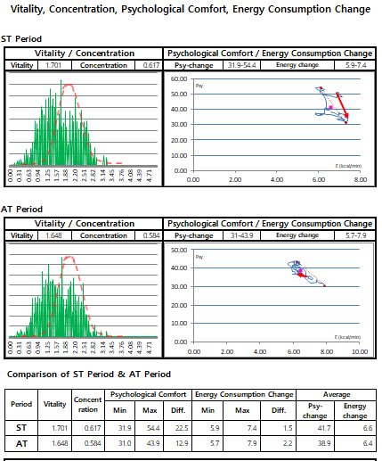

Slide 16
Advantages of Video Polygraph
Analysis technology to indicate the real time probability level of Lie on
interview and investigation
To keep sustaining Contactless, Non-restraint method
Can contribute Civil Liberty and Scientific Investigation
Can increase the reliability and accuracy by testing Psycho-Physiological
measurement and analysis before main Polygraph Investigation
World first product for analyzing Interview and Statement mode
Easy and friendly usage
Can apply to other private applications
Can develop the new market by applying the various market & industries

Slide 17
Can apply to Business
Criminal Investigation (Video Polygraph):
- 100% Compatible with Classic Polygraph
- Interview or Statement
- STIM Test
On-Line Loan system for rhe remoted interview
Human Recruiting
Marketing Research
Consulting and Etc.

Slide 18
Video Polygraph Testing Sample
(Famous Actor’s Sexual Case)

Slide 19
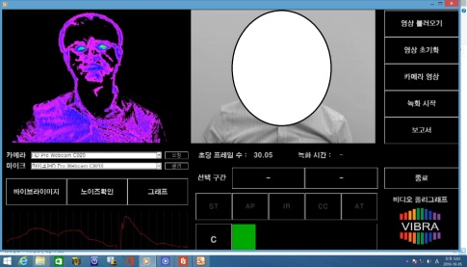
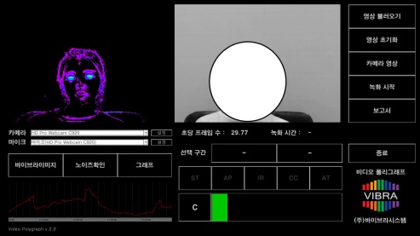
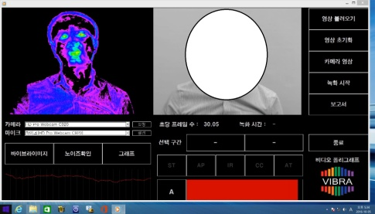
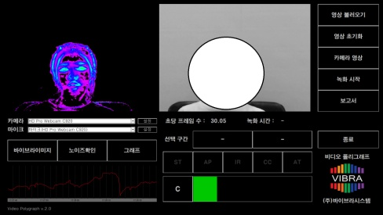
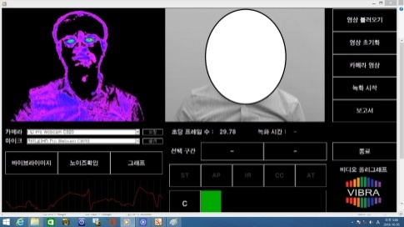
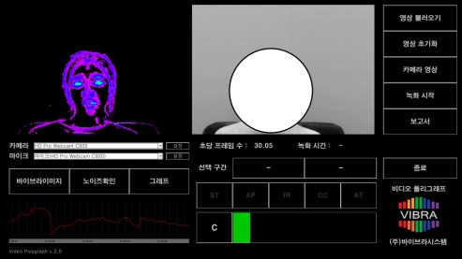
유명인의 검사사례 1 (성폭력 사건)
Man & Woman Analysis Result
Item | Man’s testing feature |  | Woman’s testing feature
ST stage |  | Stable |  | Stable
IR (Q&A) |  | IR stage 1) DI : “A” grade (Red colored bar) 2) Internal Vibraimage shows more dynamical response |  | IR stage NDI : “C ”grade (Green colored bar) 2) Internal Vibraimage : constantly stable and low response
AT stage |  | AT stage |  | AT stage

Slide 20
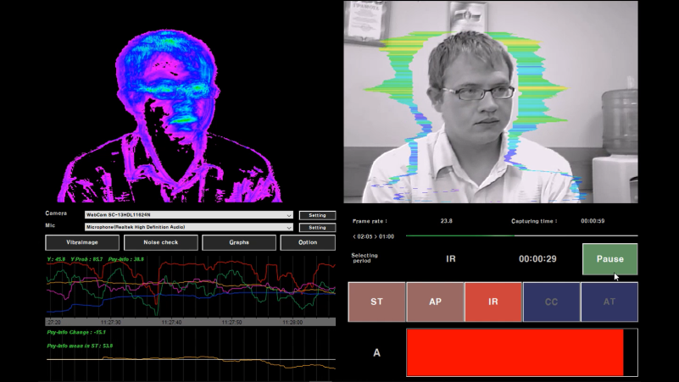
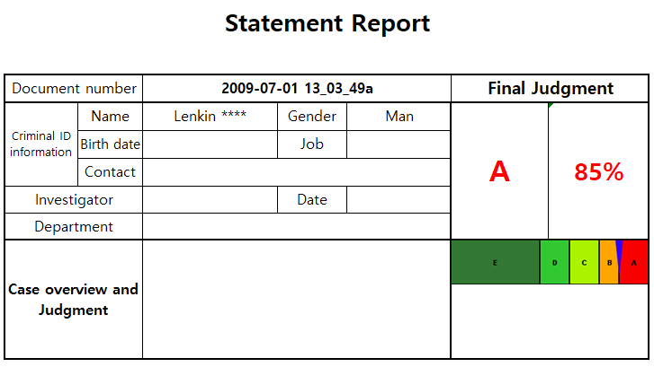
유명인의 검사사례 2 (성폭력 사건)
Result of Russian Case Analysis Result

Slide 21
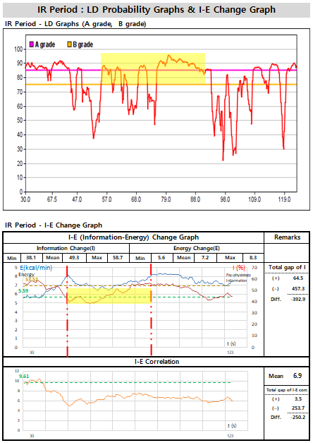
Result of Russian Case
Analysis Result
I (Information) graph
: Negative level under ST’s
average level of Information
Duration : 00:50 ~ 1:27

Slide 22
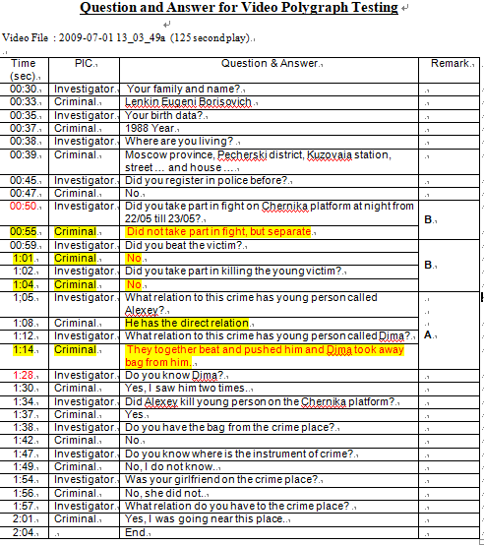
유명인의 검사사례 2 (성폭력 사건)
Result of Russian Case
Analysis Result
Question & Answer

Slide 23
World First VIDEO POLYGRAPH
Based on Vibraimage Technology
E-mail; kwan.choi@vibrasystem.co.kr
Mobile; +82-10 2305 6343

